Slide 1
HIGHWAY SERVICE SYSTEM
Android application| GPS

Slide 2
PROBLEM STATEMENT
Introducing a highway management service where customers with vehicle issues can use our website to contact nearby mechanics via GPS for emergency assistance, with mechanics alerted through our mobile app to promptly address the problem, earning payment based on the situation.

Slide 3
OBJECTIVES & OUTCOMES
Hence costumer/victim can get satisfied in emergency.
Secured by any time(24*7).
Our service provider who is working under our company can get paid and our company get be benefited.

Slide 4
REQUIREMENTS
Android Application with GPS tracker.
Service provider
Marketing the innovation idea/about the Android App.

Slide 5





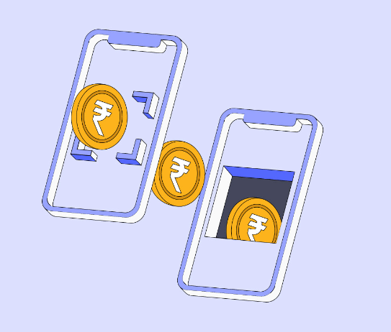




Planned Diagram
Service Provider Zone

Slide 6
IMPLEMENTATION STEPS
Develop the Website and App:
Create a user-friendly website and mobile app.
Integrate GPS functionality for real-time location tracking.
Mechanic Registration:
Onboard certified mechanics onto the platform.
Ensure they have the necessary tools and equipment.
User Registration:
Allow users to sign up and create profiles.
Provide an easy-to-use interface for reporting vehicle issues.
Request for Assistance:
Implement a feature for users to request help via the website or app.
Capture details of the vehicle issue and user location.
Emergency Alerts:
Develop an alert system to notify nearby mechanics of a service request.
Ensure mechanics receive detailed information about the issue.

Slide 7
Service Dispatch:
Enable mechanics to accept service requests and navigate to the user's location.
Provide real-time tracking for both users and mechanics.
Problem Resolution:
Mechanics assess and fix the vehicle problem on-site.
Ensure quality service through user feedback and ratings.
Payment Processing:
Facilitate payment transactions through the app.
Implement a transparent billing system based on the issue resolved.
Revenue Sharing:
Automatically deduct 30% of the service fee for the company.
Disburse the remaining payment to the mechanic.
Customer Support:
Provide 24/7 customer support for both users and mechanics.
Address any disputes or issues promptly.

Slide 8
THANK YOU

